Slide 1
Catalyst for Learning
How do you define life?

Slide 2
Properties of life

Slide 3
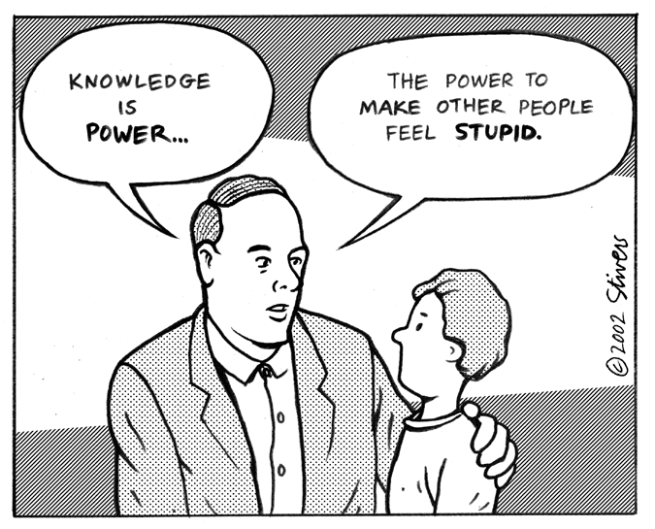
By the end of this class, I will be able to:
Define science, biology, and organism
Differentiate between living and nonliving things
List and define the seven
properties of life

Slide 4
What is science? What is Biology?
Science: using evidence to learn about the natural world
Bio= life
Logy= study of
Bio + logy = biology = the study of life

Slide 5
Life
Biology is the study of life (all living things)
Living things are called organisms
Organisms include bacteria, protists, fungi, plants, & animals

Slide 6
Who is Mr. H Creg

Slide 7
So what’s alive? Is Mr. H. Creg Alive?
Mr. H. Creg was a normal, healthy man. There was nothing in his life to indicate that he was anything different from anyone else. When he completed high school, he obtained a job in a factory, operating a machine press. On this job he had an accident and lost his hand. It was replaced with an artificial hand that looked and operated almost like a real one.
1) Is Mr. H. Creg Alive?
A) Yes B)No

Slide 8
Is Mr. H. Creg alive?
Soon afterward, Mr. H. Creg developed a severe intestinal difficulty, and a large portion of his lower intestine had to be removed. It was replaced with an elastic silicon tube.
2) Is Mr. H. Creg Alive?
A) Yes B)No

Slide 9
Is Mr. H. Creg alive?
Everything looked good for Mr. H. Creg until he was involved in a serious car accident. Both of his legs and his good arm were crushed and had to be amputated. He also lost an ear. Artificial legs enabled Mr. H. Creg to walk again, and an artificial arm replaced the real arm. Plastic surgery enabled doctors to rebuild the ear.
3) Is Mr. H. Creg Alive?
A) Yes B)No

Slide 10
Is Mr. H. Creg alive?
Over the next several years, Mr. H. Creg was plagued with internal disorders. First, he had to have an operation to remove his aorta and replace it with a synthetic vessel. Next, he developed a kidney malfunction, and the only way he could survive was to use a kidney dialysis machine (no donor was found for a kidney transplant). Later, his digestive system became cancerous and was removed. He received nourishment intravenously. Finally, his heart failed. Luckily for Mr. H. Creg, a donor heart was available, and he had a heart transplant.
4) Is Mr. H. Creg Alive?
A) Yes B)No

Slide 11
Is Mr. H. Creg alive?
It was now obvious that Mr. H. Creg had become a medical phenomenon. He had artificial limbs, nourishment was supplied to him through his veins; therefore he had no solid wastes. All waste material was removed by the kidney dialysis machine. The heart that pumped his blood to carry oxygen and food to his cells was not his original heart. But Mr. H. Creg’s transplanted heart began to fail. He was immediately placed on a heart-lung machine. This supplied oxygen and removed carbon dioxide from his blood, and it circulated blood through his body.
5) Is Mr. H. Creg Alive?
A) Yes B)No

Slide 12
Is Mr. H. Creg alive?
The doctors consulted bioengineers about Mr. H. Creg. Because almost all of his life-sustaining functions were being carried on by machine, it might be possible to compress all of these machines into one mobile unit, which would be controlled by electrical impulses from Mr. H. Creg’s brain. This unit would be equipped with mechanical arms to enable him to perform manipulative tasks. A mechanism to create a flow of air over his vocal cords might enable him to speak. To do all this, they would have to amputate at the neck and attach his head to the machine, which would then supply all nutrients to his brain. Mr. H. Creg consented, and the operation was successfully performed.
6) Is Mr. H. Creg Alive?
A) Yes B)No

Slide 13
Is Mr. H. Creg alive?
Mr. H. Creg functioned well for a few years. However, a slow deterioration of his brain cells was observed and was diagnosed as terminal. So the medical team that had developed around Mr. H. Creg began to program his brain. A miniature computer was developed: it could be housed in a machine that was humanlike in appearance, movement, and mannerisms. As the computer was installed, Mr. H. Creg’s brain cells completely deteriorated. Mr. H. Creg was once again able to leave the hospital with complete assurance that he would not return with biological illness.
7) Is Mr. H. Creg Alive?
A) Yes B)No

Slide 14
So… Is Mr. H. Creg alive?
If Mr. H. Creg is not alive at the story's end, exactly when did he stop being alive?
With a partner create a list of characteristics that define a living thing
Come up with at least 3 things

Slide 15
All living things share:
We can remember the 7 properties of life by remembering : MR H CREG
M= Metabolism
R= Reproduction
H= Homeostasis
C= Cellular Organization
R= Response to Environment
E= Evolution
G= Growth & Development

Slide 16
How do you know it’s living?
A living MUST have all seven properties of life to be considered living
No exceptions!

Slide 17
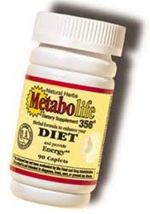
What is metabolism?
Metabolism is all of the chemical processes in an organism
It is also the ability to use energy
Think: why is it that some people can
eat fried, fatty foods every day and
not gain weight?

Slide 18
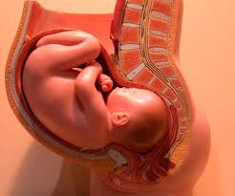
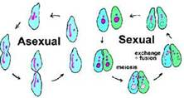
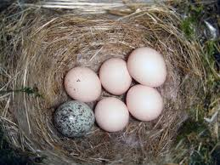
What is reproduction?
The ability to have offspring that can reproduce
Two types

Slide 19
What is homeostasis?
Internal balance
Ex: Shivering
Why do you shiver?
Ex: Sweating
Why do we sweat?
Can you think of another
example???

Slide 20
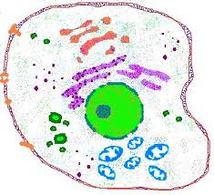
What is cellular organization?
Cell= basic unit of life
All living things are made of cells
For example, human bodies are made of skin cells, heart cells, brain cells
What about a virus???

Slide 21
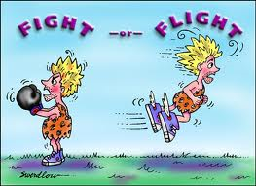
What is response to environment? (stimulus)
Think: reaction
Ex: If a lion is chasing after you, what’s going to happen?
Ex: If a plant isn’t getting enough sunlight, what’s going to happen?

Slide 22
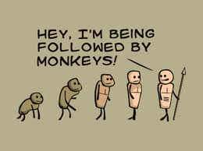
What is evolution?
Change over time
Ex: Scientists have argued that giraffes now have longer necks because giraffes with longer necks were able to reach more food and therefore survived

Slide 23
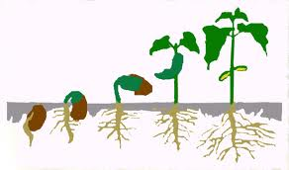
What is growth and development?

Slide 24
Living or Non-Living Activity
Write the name of the item.
Classify the item as “Living” or “Non-Living”.
List 2 characteristics of life (for Living) or 2 reasons (for non-living)

Slide 25
Dog

Slide 26
swimmer

Slide 27
rock

Slide 28
Carnivorous plants

Slide 29
car

Slide 30
flowers

Slide 31
Venus Fly Trap

Slide 32
Saltwater fish

Slide 33
Coral reef

Slide 34
Euglena

Slide 35
skyscrapers

Slide 36
Results
1. Living
2. Living
3. Non-Living
4. Living
5. Non-Living
6. Living
7. Living
8. Living
9. Living
10. Living
11. Non-Living
12. ?

