Slide 1
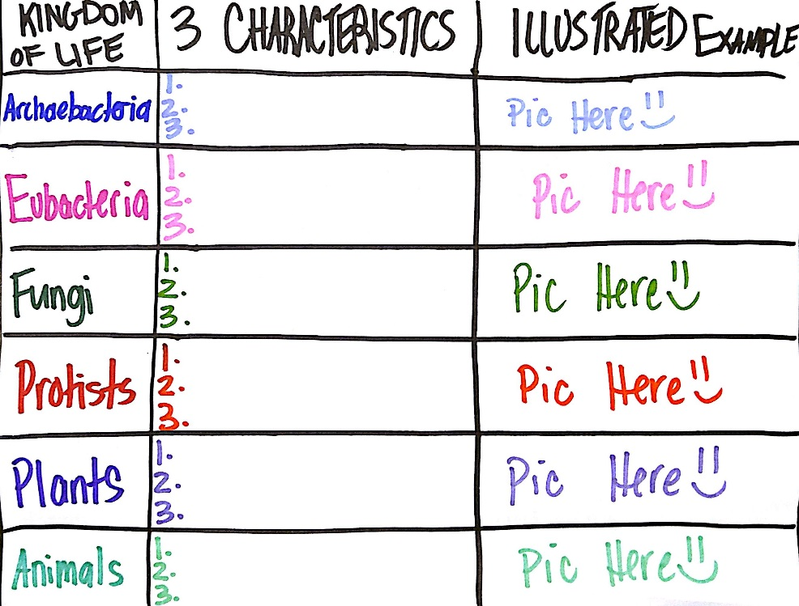
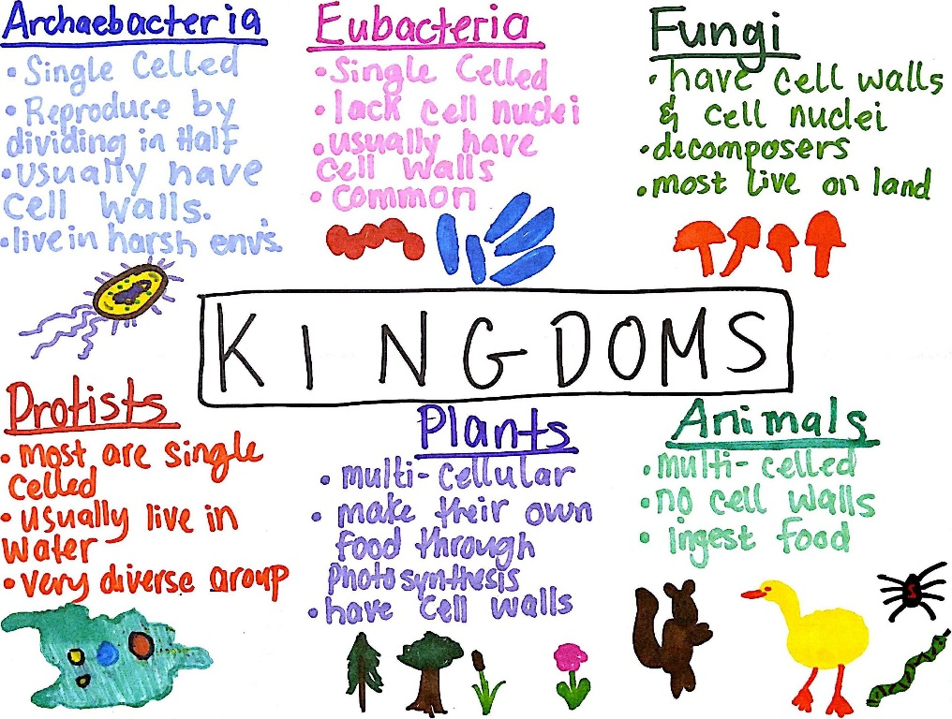
Kingdoms of Life Graphic Organizer
Create a graphic organizer with the 6 Kingdoms of Life.
Archaebacteria, Eubacteria, Protists, Fungi, Plants, Animals
Provide 3 characteristics for each
Be sure to look at cell walls and # of cells.
Draw 1+ picture(s) for each
Use COLOR!
See pgs. 108-113

