Slide 1
Atmosphere Review Warm-Up
Write your answers in complete sentences!
1. Explain the greenhouse effect.
2. What are the three methods of heat transfer in the atmosphere?
3. What is the purpose of ozone?

Slide 2
Drop in the Bucket
What do you think….
How much of Earth’s water is…
Freshwater?
Non-frozen?
Clean and ready to use?

Slide 3
Mini-Movie Marathon Time!
https://www.youtube.com/watch?v=4b2kdcEuWr4
https://www.youtube.com/watch?v=UYROQW9IDIg

Slide 4
Water Resources
Water is essential to life on Earth. Humans can live for more than month without food, but we can live for only a few days without water.
Two kinds of water found on Earth:
Fresh water, the water that people can drink, contains little salt.
Salt water, the water in oceans, contains a higher concentration of dissolved salts.
Most human uses for water, such as drinking and agriculture, require fresh water.

Slide 5
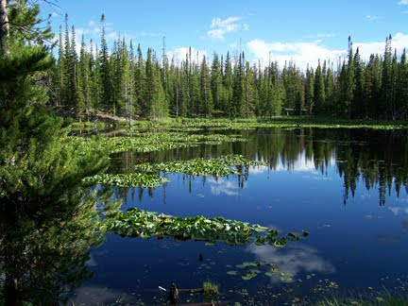
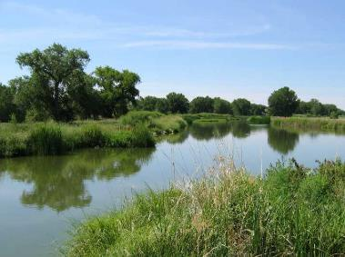
Surface Water
The fresh water on Earth’s land surface.
Found in lakes, rivers, streams, and wetlands.

Slide 6
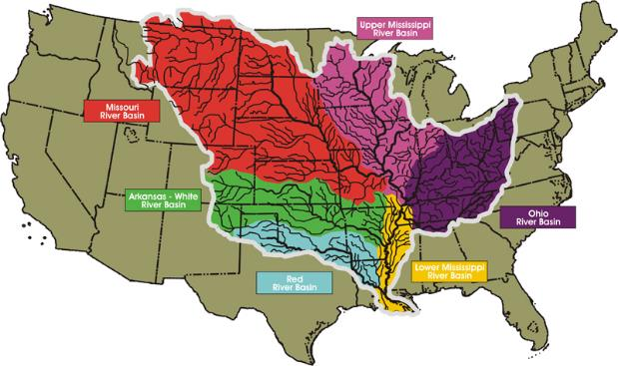
River Systems
As streams and rivers move across the land, they become a flowing network of water called a river system.

Slide 7
Watersheds
A watershed is the area of land that is drained by a water system.
The amount of water that enters a watershed varies throughout the year.
Rapidly melting snow as well as spring and summer rains can dramatically increase the amount of water in a watershed. At other times of the year, the river system that drains a watershed may be reduced to a trickle.

Slide 8
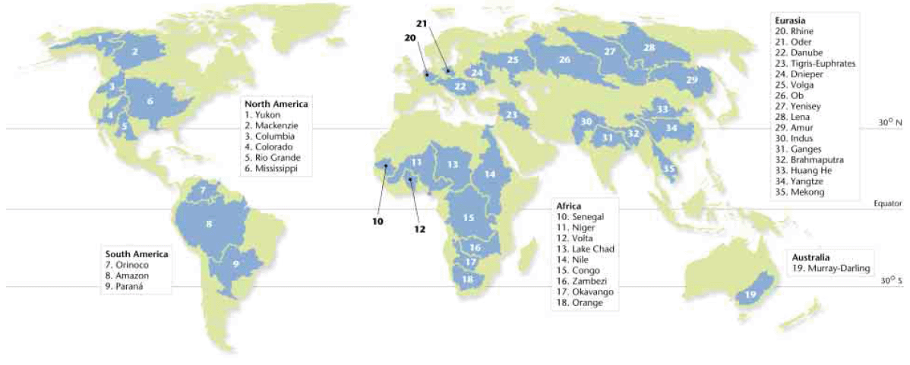
Watersheds

Slide 9
Groundwater
Most of the fresh water that is available for human use cannot be seen, as it exists underground.
When it rains, some of the water that falls onto the land flows into lakes and streams. But much of the water percolates through the soil and down into the rocks beneath.
Groundwater is the water that is beneath the Earth’s surface.

Slide 10
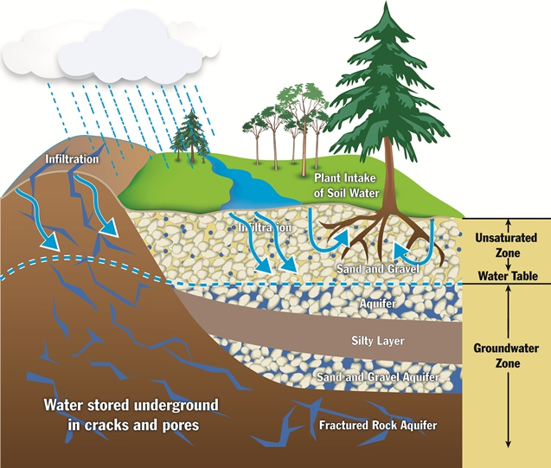
Groundwater

Slide 11
Aquifers
An aquifer is an underground formation that stores and allows the flow of groundwater. They are an important water source for many cities.
The water table forms the upper boundary of an aquifer, and most aquifers consist of materials such as rock, sand, and gravel that have a lot of spaces where water can accumulate.
Groundwater can also dissolve rock formations, filling vast caves with water and creating underground lakes.

Slide 12
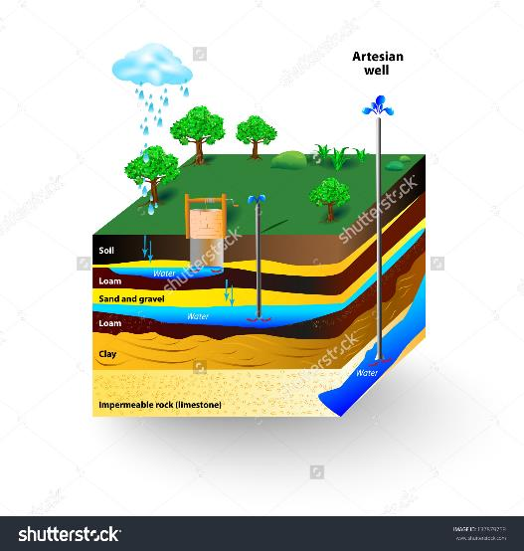
Aquifers

Slide 13
The Recharge Zone
To reach an aquifer, surface water must travel down through permeable layers of soil and rock. Water cannot reach an aquifer from places where the aquifer is covered by impermeable materials.
The recharge zone is an area in which water travels downward to become part of an aquifer.
Recharge zones are environmentally sensitive areas because any pollution in the recharge zone can also enter the aquifer.

Slide 14
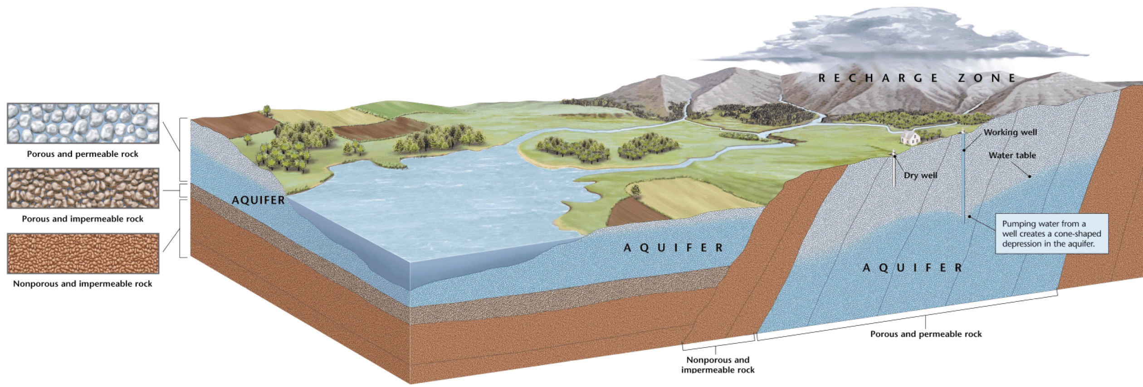
The Recharge Zone

Slide 15
Wells
A hole that is dug or drilled to reach groundwater is called a well.
Humans have dug wells to reach groundwater for thousands of years.
We dig wells because ground water may be a more reliable source of water than surface water and because water is filtered and purified as it travels underground.

Slide 16
Water Use and Management
When a water supply is polluted or overused, everyone living downstream can be affected.
A shortage of clean, fresh water is one of the world’s most pressing environmental problems.
According to the World Health Organization, more than 1 billion people lack access to a clean, reliable source of fresh water.

Slide 17
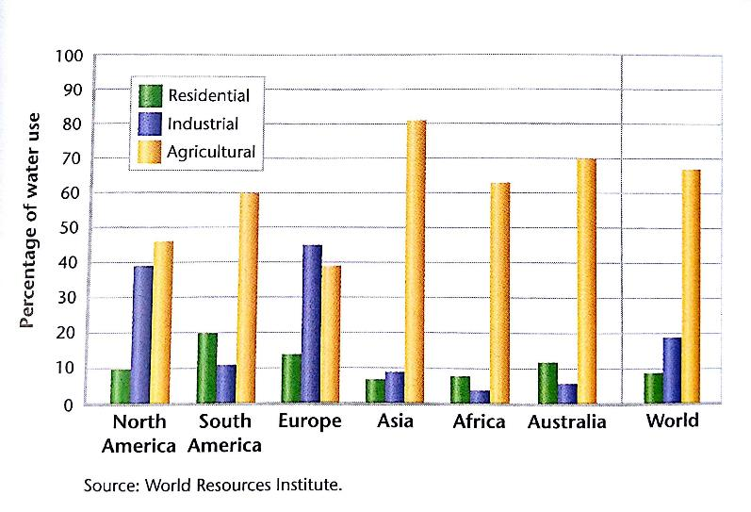
Water Use and Management

Slide 18
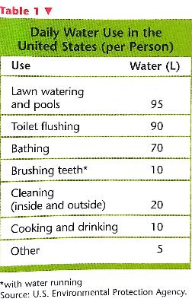
Residential Water Use
In the US, the average person uses 300L (80 Gal) of water per day.
In India, the average person uses 80L (11 Gal) of water per day.

Slide 19
Water Treatment
Most water must first be made potable.
Potable means suitable for drinking.
Water treatment removes elements such as mercury, arsenic, and lead, which are poisonous to humans even in low concentrations.
These elements are found in polluted water, but they can also occur naturally in groundwater.

Slide 20
Water Treatment
Pathogens are found in water contaminated by sewage or animal feces, but can be removed with water treatment.
A pathogen is a virus, microorganism, or other substance that causes disease.
There are several methods of treating water to make it potable. A common method includes both physical and chemical treatment.

Slide 21
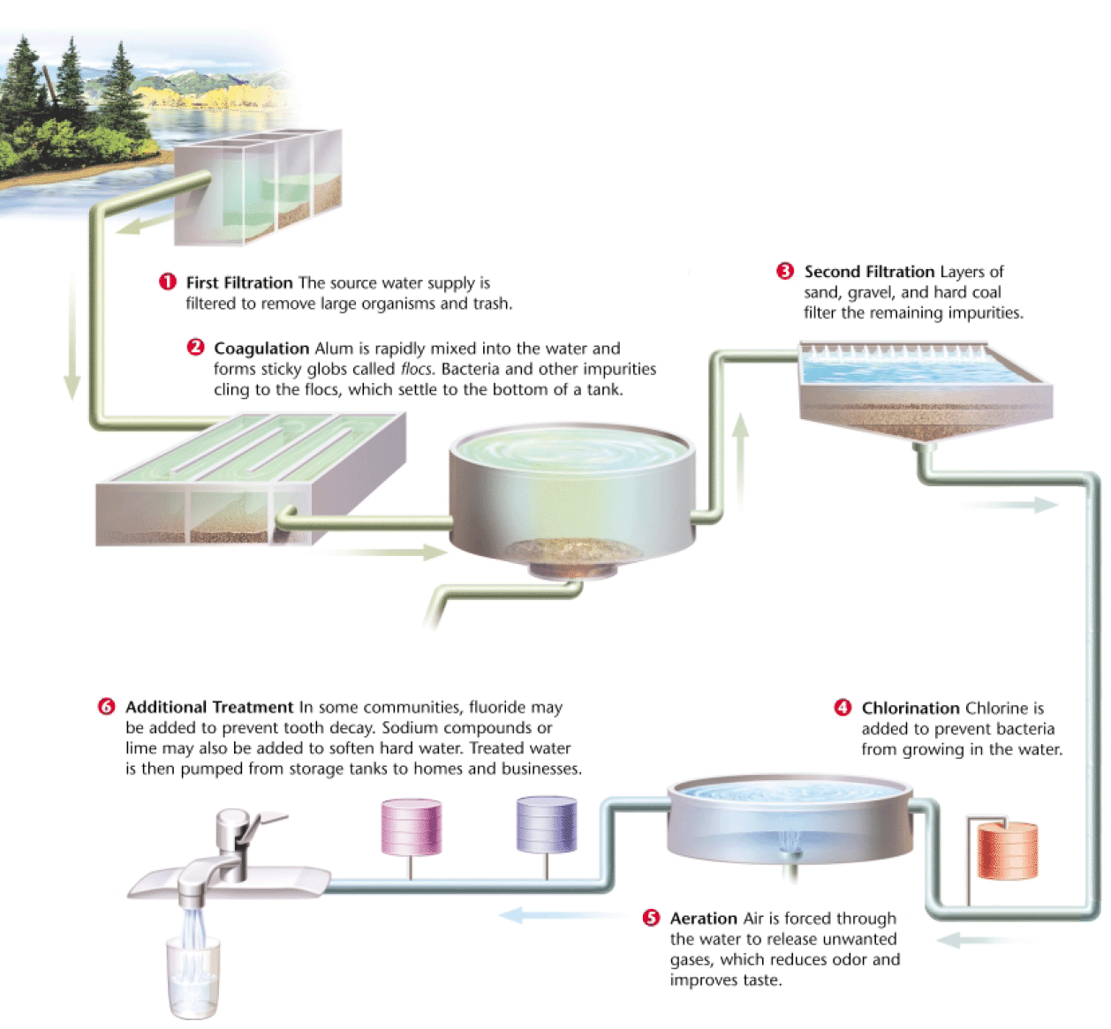
Drinking-Water Treatment

Slide 22
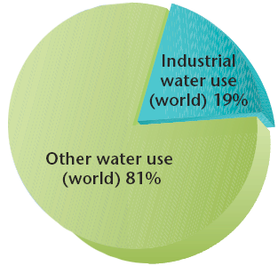
Industrial Water Use
Industry accounts for 19 percent of water used in the world.
Water is used to manufacture goods, to dispose of wastes, and to generate power.

Slide 23
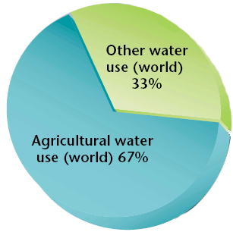
Agricultural Water Use
Agriculture accounts for 67 percent of the water used in the world. Plants require a lot of water to grow, and as much as 80 percent of the water used in agriculture evaporates.
It can take up to 300L (80 Gal) of water to grow one ear of corn!

Slide 24
Irrigation
Irrigation is a method of providing plants with water from sources other than direct precipitation.
Many different irrigation techniques are used today. For example, some crops are irrigated by shallow, water filled ditches.
In the U.S., high-pressured overhead sprinklers are the most common form of irrigation. However, this method is inefficient because nearly half the water evaporates and never reaches the plant roots.

Slide 25
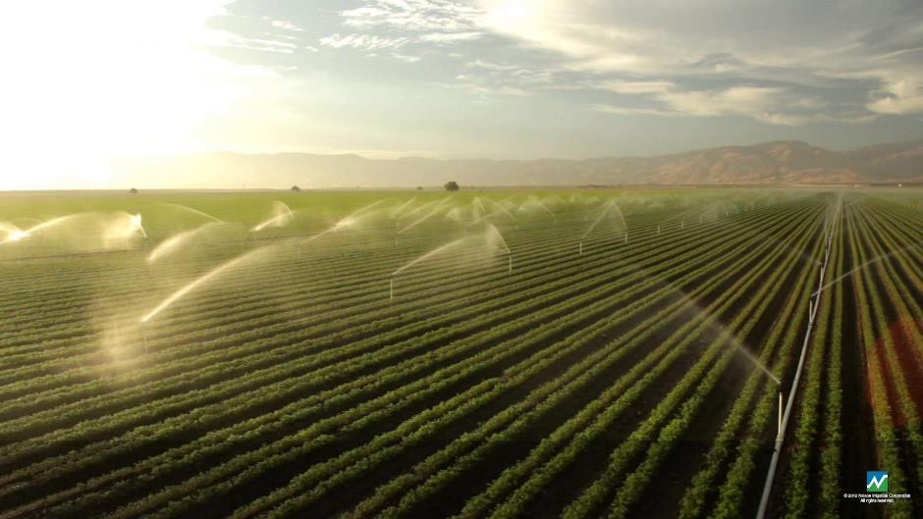
Irrigation

Slide 26
Water Management
People often live in areas where the natural distribution of surface water is inadequate.
Water management projects have allowed people to live in various places that they otherwise could not, like the US Southwest and other deserts.

Slide 27
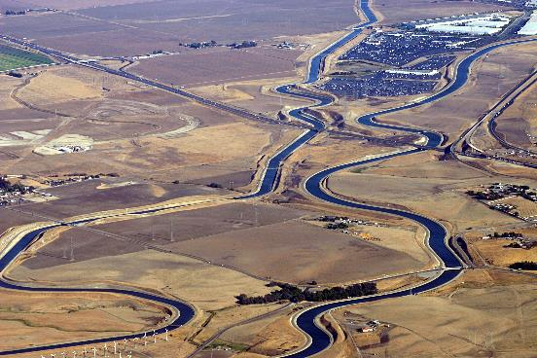
Water Diversion
To supply dry regions with water, all or part of a river can be diverted into canals that carry water across great distances.

Slide 28
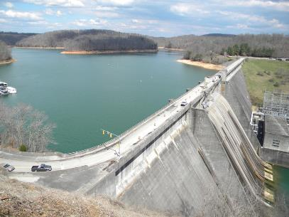
Dams and Reservoirs
A dam is a structure that is built across a river to control a river’s flow.
A reservoir is an artificial body of water that usually forms behind a dam. Water from a reservoir can be used for flood control, drinking water, irrigation, recreation, and industry.
Hydroelectric dams use the power of flowing water to turn a turbine that generates electrical energy. About 20 percent of the world electrical energy is generated using this method.

Slide 29
Water Conservation
As water sources become depleted, water becomes more expensive.
This is because wells must be dug deeper, water must be piped greater distances, and polluted water must be cleaned up before it can be used.
Water conservation is one way that we can help ensure that everyone will have enough water at a reasonable price.

Slide 30
Water Conservation at Home
Take shorter showers, and avoid taking full baths.
Install low-flow shower heads.
Install low-flow aerators in your water faucets at home.
Purchase a low-flow toilet, install a water-saving device in your toilet, or place a water-filled bottle in your toilet tank to reduce the water used for each flush.
Do not let the water run while brushing your teeth.
Fill up the sink rather than letting the water run when you are shaving, washing your face, or washing dishes.
Wash only full loads in the dishwasher and washing machines.
Water your lawn sparingly.

Slide 31
Desalination
Desalination is the process of removing salt from ocean water.
Some countries in drier parts of the world, such as the Middle East, have built desalination plants to provide fresh water.
Most desalination plants heat salt water and collect the fresh water that evaporates.
Because desalination consumes a lot of energy, the process is too expensive for many nations to consider.

Slide 32
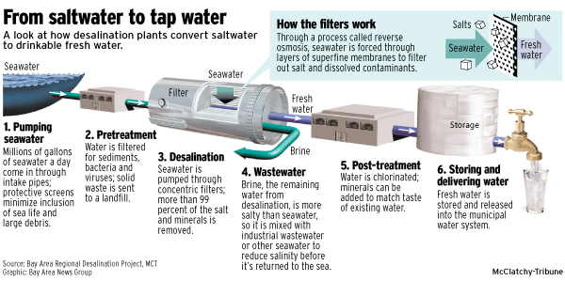
Desalination

Slide 33
Water Pollution
Water pollution is the introduction into water of waste matter or chemicals that are harmful to organisms living in the water or to those that drink or are exposed to the water.
Almost all of the ways that we use water contribute to water pollution.
However, the two underlying causes of water pollution are industrialization and rapid human population growth.

Slide 34
Point-Source Pollution
When you think of water pollution, you probably think of a single source, such as a factory, a wastewater treatment plant, or a leaking oil tanker. These are all examples of point-source pollution.
Point-source pollution is pollution that comes from a specific site.

Slide 35
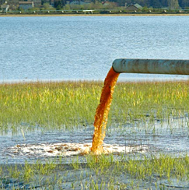
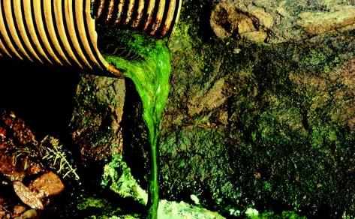
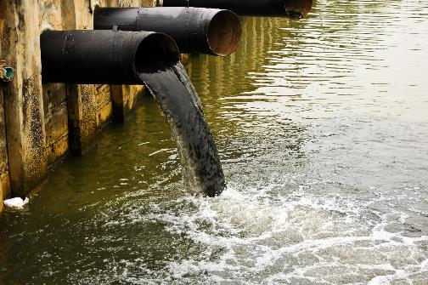
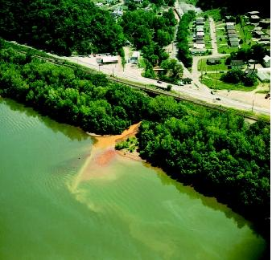
Point-Source Pollution

Slide 36
Nonpoint-Source Pollution
Nonpoint source pollution is pollution that comes from many sources rather than from a single specific site. An example is pollution that reaches a body of water from streets and storm sewers.

Slide 37
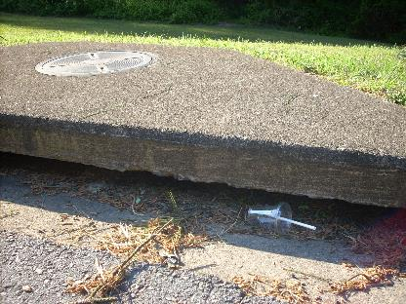
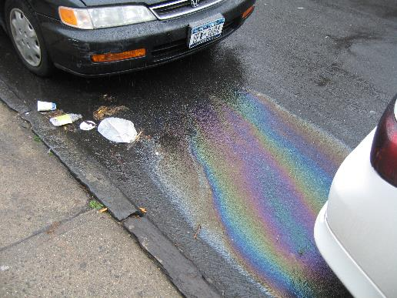
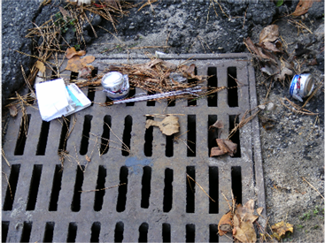
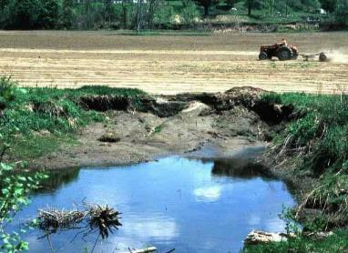
Nonpoint-Source Pollution

Slide 38
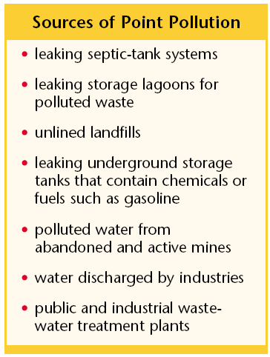
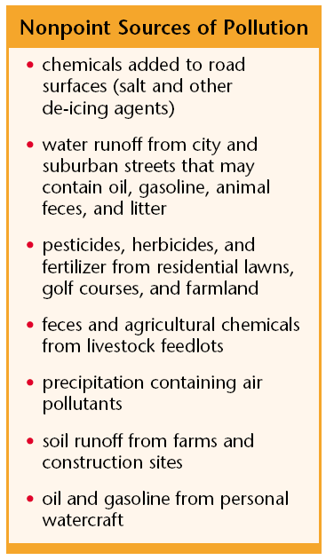
Point and Nonpoint Sources of Pollution

Slide 39
Wastewater
After water flows down the drain in the sink, it usually flows through a series of sewage pipes that carry it, along with all the other wastewater in your community, to a wastewater treatment plant.
Wastewater is water that contains wastes from homes or industry.
At a wastewater treatment plant, water is filtered and treated to make the water clean enough to return to a river or lake.

Slide 40
Wastewater Treatment Process

Slide 41
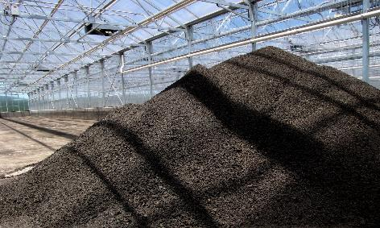
Sewage Sludge
One of the products of wastewater treatment is sewage sludge, the solid material that remains after treatment.
When sludge contains dangerous concentrations of toxic chemicals, it must be disposed of as hazardous waste. It is often incinerated, and then the ash is buried in a secure landfill.
Sludge can be an expensive burden to cities as the volume of sludge that has to be disposed of every year is enormous.

Slide 42
Artificial Eutrophication
Remember that eutrophication happens when lakes or streams contain an abundance of nutrients.
This can be a natural process, but when humans cause it it’s called artificial eutrophication.
Fertilizer runoff from lawns, farms, and gardens is the largest source of nutrients that cause artificial eutrophication.
Phosphates from laundry and dishwashing detergents are also major causes of eutrophication.

Slide 43
Thermal Pollution
Thermal pollution occurs when the temperature of a body of water increases.
This can occur when industries and power plants discharge warm water used for cooling their systems into a body of water.
Rapid changes can cause large fish kills and slower changes can slowly decrease the oxygen in the water, eventually killing many aquatic organisms.

Slide 44
Groundwater Pollution
Pollutants usually enter groundwater when polluted surface water percolates down from the Earth’s surface.
Any pollution of the surface water in an area can affect the groundwater.
Pesticides, herbicides, chemical fertilizer, and petroleum products are common groundwater pollutants. Other sources of pollution include septic tanks, unlined landfills, and industrial wastewater lagoons.

Slide 45
Cleaning Up Groundwater Pollution
Groundwater pollution is one of the most challenging environmental problems in the world.
Groundwater recharges very slowly, so the process for some aquifers to recycle water and purge contaminants can take hundreds of years.
Also, pollution can cling to the materials that make up an aquifer, so even if all of the water in aquifer were pumped out and replaced with clean water, the groundwater could still become polluted.

Slide 46
Ocean Pollution
Pollutants are often dumped directly into the ocean. For example, ships can legally dump wastewater and garbage overboard in some parts of the ocean.
85% of ocean pollution (including oil, toxic waste, and medical waste) comes from land activities.

Slide 47
Oil Spills
Oceans are also polluted by accidental oil spills.
Each year, approximately 37 million gallons of oil from tanker accidents are spilled into the oceans.
While dramatic, oil spills only account for 5% of oil pollutions in the oceans.
200-300 million gallons of oil enters the ocean every year from non-point sources on land.

Slide 48
Water Pollution and Ecosystems
Water pollution can cause immediate damage to an ecosystem, but the effects can be far reaching as some pollutants build up in the environment because they do not decompose quickly.
Biomagnification is the accumulation of pollutants at successive levels of the food chain.
Biomagnification has alarming consequences for organisms at the top of the food chain, and is one reason why U.S. states limit the amount of fish people can eat from certain bodies of water.

Slide 49
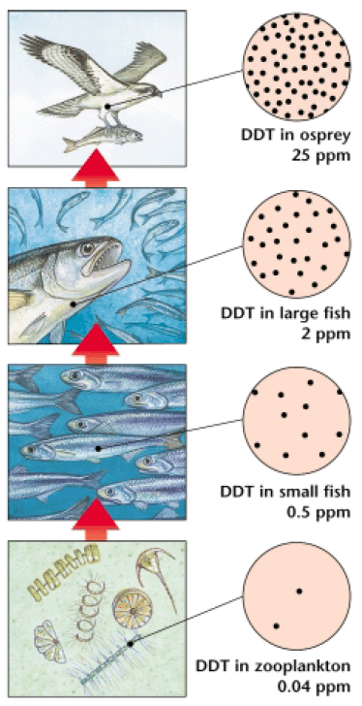
Water Pollution and Ecosystems

Slide 50
Cleaning Up Water Pollution
The Clean Water Act of 1972 was to designed to “restore and maintain the chemical, physical, and biological integrity of the nation’s waters.”
The goal of making all all surface water clean enough for fishing and swimming by 1983 was never achieved, but much progress has been made since the act was passed.
The percentage of lakes that are fit for swimming has increased by 30 percent, and many states have passed stricter water-quality standards.

